Slide 1

Thank you to our generous donors!
Blue Cross Blue Shield of Massachusetts
Nancy Ridley

Slide 2
An Improvement Model for Patient Centered Care
Evan M. Benjamin, MD
Senior Vice-President and
Chief Quality Officer, Baystate Health
Professor of Medicine Tufts University School of Medicine
Stephanie Calcasola, MSN, RN-BC
Director of Quality
Baystate Medical Center
April 2014

Slide 3
Background
Clinical effectiveness, patient safety and patient experience are increasingly recognized as the three pillars of healthcare.
Patients and families view the experience of care in its entirety, not as separate components
Evidence shows that improving the patient experience and developing partnerships with patients are linked to improved health outcomes.
Centers for Medicare & Medicaid Services (CMS) reimbursement is impacted by a hospital’s ranking relative to its peers (IHI, 2011)
Historically been viewed as a nice-to-have, not a fundamental aspect of a health care organization’s attention

Slide 4
Multiple Forces are Changing the Landscape of Patient and Family Centered Care
Push Forces | Pull Forces
Consumer movement Patient rights Patient safety movement Transparency demand Healthcare reform Accrediting agencies AARP, Consumer reports, national quality forum, IHI, Lucien Leape Institute, Picker Institute, Planetree – all working to advance patient /partnerships | Organizing the healthcare system around the patient and family works for everyone Optimizing the patient experience correlates with improved quality and patient safety and staff satisfaction Patient activation and self-management is enhanced, achieving better chronic disease outcomes Health care providers seek and want better experiences for those they serve and their own families
IHI, 2011

Slide 5
Leadership Role: BH Strategic Plan
our Vision
Baystate Health will transform the delivery and financing of health care to provide a high quality, affordable, integrated and patient-centered system of care that will serve as a model for the nation.

Slide 6





5 Leadership Role: BH Strategic Plan Goals
Quality Leadership
Lead nationally in quality outcomes and patient experience.
Growth & Financial Stewardship
Make health care more affordable and keep our organization strong.
Care Innovation & Integration
Innovate and integrate patient-centered care.
Academic
Innovation
Organizational
Engagement
Advance health through education and research.
Engage all employees and enhance their capabilities for success.

Slide 7
BH Adopts IOM Healthcare Aims - 2005
Safe: No patient is injured by care
Effective: 100% adherence to science in care; no needless deaths or suffering
Patient-Centered: Customized care; “every patient is the only patient”
Timely: No unwanted waiting anywhere
Efficient: No waste
Equitable: Race and wealth do not predict care or outcomes

Slide 8
Framework for Improvement
Strategic Goals
Microsystems
Engage Staff
Infrastructure

Slide 9
BMC Patient Experience Drivers
Primary Drivers:
Secondary Drivers:
Nurses Respect
SMILE communication competency
“Manage up”
Communication with Nurses
Nurse Listen
Nurse Explain
AIDET communication competency
Bedside rounds
Manage up
AIM:
Communication with Doctors
Doctor Respect
Doctor Listen
Excellent
Patient
Experience
Doctor Explain
Responsiveness of Staff
Call Button
Hourly Rounding : 3 Ps
Bedside Report
Nurse Leader Rounds
No pass zone commitment
Bathroom Help
Communication About Medications
Medications Explanation
Medication Side Effects
Ask me 3/Teach Back
Use Lexicomp as standard reference tool
Hospital Environment
Cleanliness
Quiet for Healing Program
Quiet
Discharge Information
Help After Discharge
Follow up phone calls
Symptoms to Monitor

Slide 10
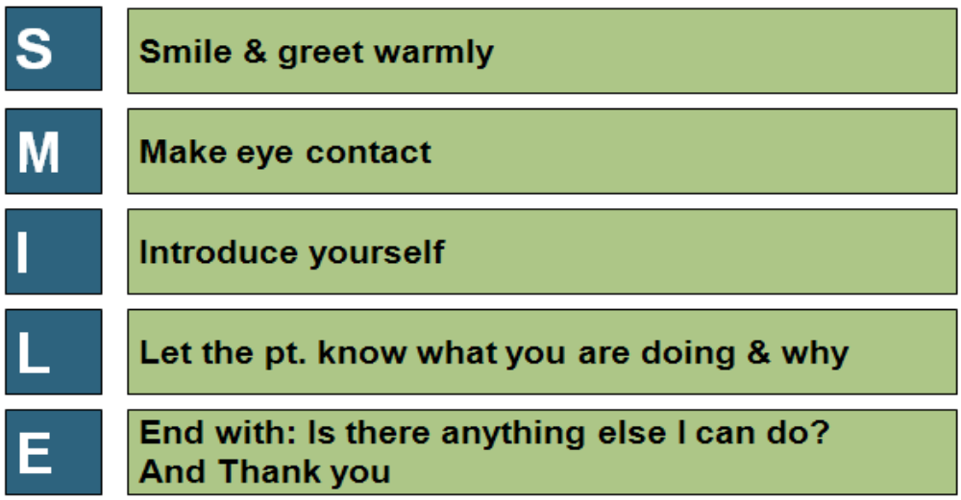
FY 14 Patient Experience Initiatives
Ongoing
  No Pass Zone
  Hourly Rounding
  Patient Experience Leadership Rounds
  Communication with Caring Training
  SMILE =
New
  Quiet Process Team
  Appearance Standards
Evaluation Phase
  Service Recovery and Standards Program

Slide 11
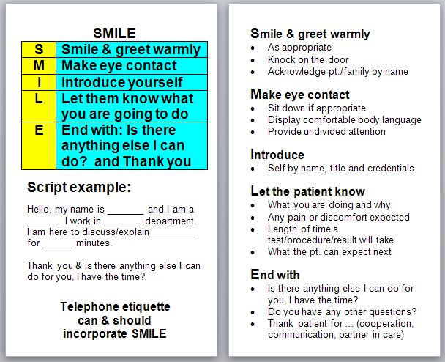
SMILE
Communication with Caring

Slide 12
Exceptional Care
http://www.youtube.com/watch?v=nMvv4XeYx10&list=PLtgMe6T9KPycmwtK0nzUY7ShjhW9VnXaC&feature=c4-overview-vl

Slide 13
Milford Regional Medical Center: Patient and Family Advisory Council
An Integrated Approach to Improving the Behavioral Health System
Jeffrey Hopkins, MD – Chair, Dept. of Emergency Medicine
Beverly Swymer, Chair – PFAC Behavioral Health Sub-Committee

Slide 14

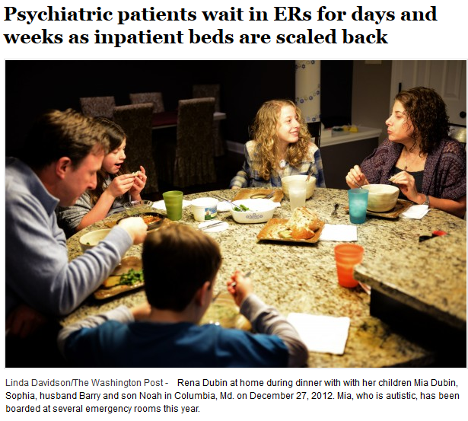

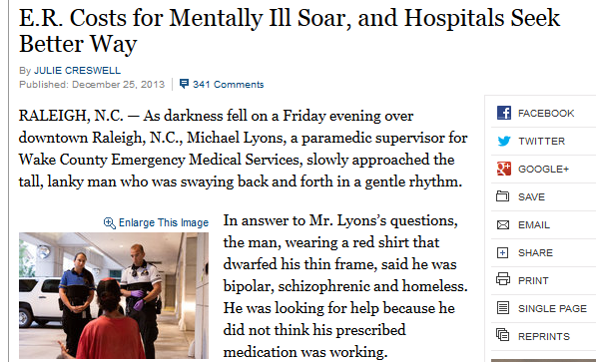
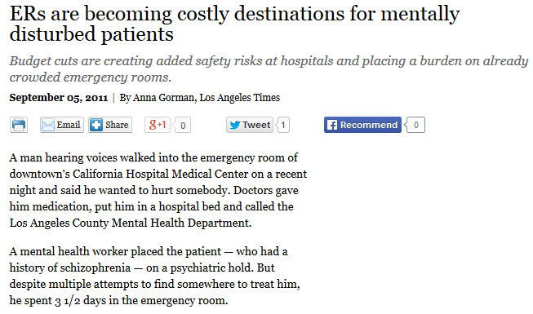

Slide 15
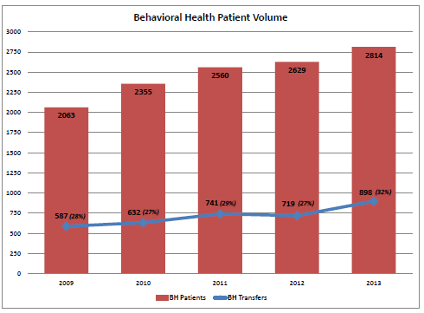

Slide 16
MRMC 2013 Data: Parity?
“MEDICAL” TRANSFERS
BEHAVIORAL HEALTH TRANSFERS
1658 PATIENTS
MEDIAN LOS:
  3 HOURS
LONGEST STAY:
  11 HOURS
765 PATIENTS
MEDIAN LOS:
  21 HOURS
LONGEST STAY:
  386 HOURS
  (16 DAYS)

Slide 17

BOARDERS WITHOUT DOCTORS
“We put them in a windowless room with a ‘sitter’ staring at them day and night, with minimal exercise and no one paying attention to them, often not getting regular meals”

Slide 18

FOCUS ON BEHAVIORAL HEALTH
PFAC Behavioral Health Sub-Committee
  PFAC Community Members
  Case Management
  Emergency Department Staff (physicians, nurses, security)
  Families of Patients with Mental Illness
  Adolescent Health Center
  Psychiatric Emergency Service Provider
Patient Safety Assistant Program (PSA)
Division of Behavioral Health
Daily Behavioral Health Rounds/Huddles
Monthly Interdisciplinary Review of BH Cases

Slide 19
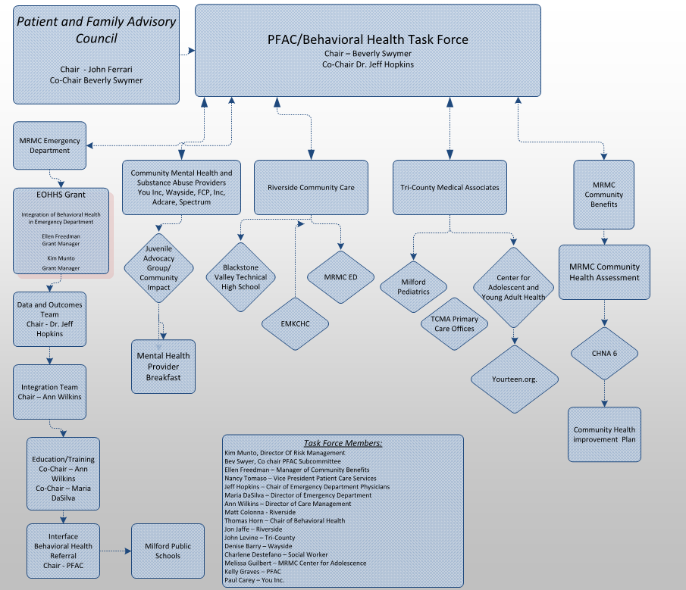
BEHAVIORAL
HEALTH
TASK
FORCE

Slide 20
Massachusetts
Executive Office Of Health and Human Services (EOHHS) Grant
BEHAVIORAL HEALTH NURSES in the ED
  2.8 FTE for 6 months
TRAINING/EDUCATION
  3 day training for ED nurses and staff regarding pharmacology, mental health assessment and treatment options
RERERRAL SERVICE
  Contracted with behavioral health resource and referral service through MA School of Professional Psychology

Slide 21
Outcomes (so far…)
INDIVIDUALIZED MANAGEMENT PLANS
  12 patients
  # ED visits (4-mos PRE vs. POST plans)
  PRE: 89 (7.4 visits/patient)
  POST: 16 (1.3 visits/patient)
  Reduced ED Recidivism by 73 visits (6 visits/patient)
REDUCED USE OF RESTRAINTS
  25% reduction in rate of physical restraints

Slide 22
Lessons learned and the future
Multi-Disciplinary Teams working together can make a Positive Impact!
Baby Steps
Behavioral Health visits continue to INCREASE
State & Federal help is needed to ensure PARITY
Continued efforts/resources are needed

Slide 23
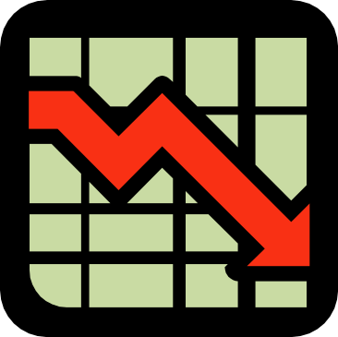
BETH ISRAEL DEACONESS HOSPITAL-PLYMOUTH
DECREASING CAUTI RATES
BY DECREASING DEVICE DAYS
IN THE CRITICAL CARE CENTER

Slide 24
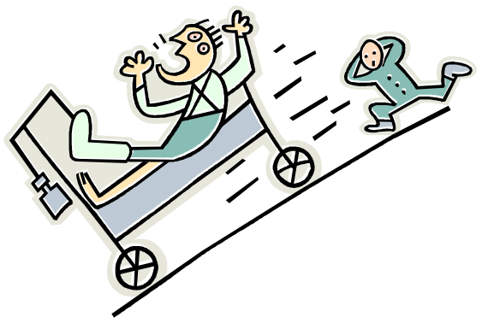
THE PROBLEM PRESENTS ITSELF
Our CAUTI Rates and Device Days were up to 3x the National rates
Our Emergency Department was placing indwelling urinary catheters in 74% of admitted patients
We knew we could do better!

Slide 25
WHAT WAS IN OUR TOOLBOX?
We relied on MHA CAUTI Cohort data to set our goals
We had a good relationship with the Director of the CCC and the Medical Director of the ED
We used evidence based practices to begin discussions with staff
We had a very supportive Senior Leadership Team

Slide 26
LESSONS LEARNED AND SURPRISES UPTURNED!
We learned that if you ask the questions of staff, they have lots of ideas and answers
We learned that staff did not understand the concept of device days as it related to CAUTI
We were surprised that there was only one size of condom catheter available to staff
We were surprised that daily rounding was not done consistently
We were not surprised that staff was resistant to change!

Slide 27
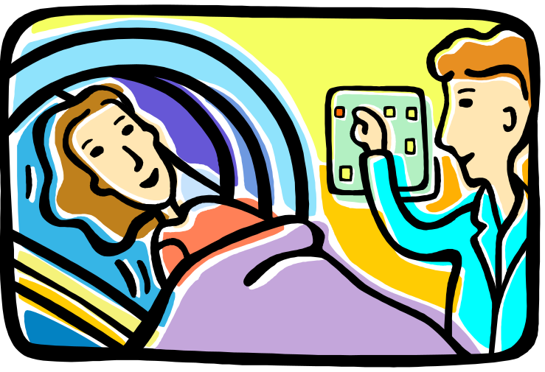
PATIENT ENGAGEMENT
We did not initially engage our patients
Now, the CCC staff shares their successes and the processes in place with patients and visitors

Slide 28
EVERY BABY STEP REVEALS A STORY
“Urban Legends” lead to practice if not perceptions!
Each step of the way we untangled and re-educated on any “rumors” or “legends” that were held as truths.
Staff in Critical Care were particularly “stuck” on the idea of every critical patient needing a Foley catheter.
We taught the importance of weighing patients and returning patients to pre-hospital toileting practices ASAP, even in the CCC!
We are looking forward to CAUTI Cohort 8 which engages us with the ED and Nursing Units to decrease CAUTI.

Slide 29
Advice, Barriers and Changes
Advice: Start at the beginning: where are the majority of your catheters placed? THAT is where the education should begin. We started in the ED, and cut placement of Foley catheters on admitted patients by 2/3.
Barriers: Urban Legends and “Old School” way of doing things
Changes we’d make?: We are pleased with our project. Our CCC CAUTI rate is at ZERO for one year and counting and our device days are down by 30%. We are spreading the processes and goals throughout the hospital presently.

Slide 30
Q & A / Discussion

